Slide 1
The good location for a coffee&tea store in Ottawa?
Yuqing He

Slide 2
Background
With the Canadian Coffee Association reporting 72 percent of Canadians consumed coffee in 2018 (up slightly from 71 percent in 2017), Coffee is a massive industry to explore.
Similarly, the tea segment also continues to experience growth, according to Shabnam Weber, president of the Toronto-based Tea and Herbal Association of Canada (THAC).

Slide 3
Research Question
Which type of location is good for setting up a coffee&tea store in Ottawa?

Slide 4
Framework
Demographics: who will purchase coffee and tea?
Competition: whether there are a lot of competitors around? ➢
Neighboring: who are your neighborhoods? ➢
Traffic Situation: how is the traffic situation around your location?

Slide 5
Data and Methodology
From the Yelp Fusion API, we can obtain the parameters including (Data size: 416):
a. Alias: the unique identification for each of the business. For example, “Starbucks-1”, “Starbucks-2”
b. Name: the name of the business. For example, “Starbucks”
c. Latitude&longitude&Zip Codes: the locations of businesses
d. Phone: phone numbers of business
e. Address: the detailed address of businesses
f. Rating: the ratings for each of the business, from 0 to 5
g. Review_counts: how many customers provide a review for this business

Slide 6
Data and Methodology
From the Foursquare API, we can obtain the parameters including (Data size: 14774):
a. Alias: the unique identification for each of the business. For example, “Starbucks-1”, “Starbucks-2”
b. Latitude&longitude&Zip Codes: the locations of businesses
c. Venues: the name of the businesses around the coffee&tea shops
d. Venues Latitude&longitude: the locations of the neighbors
e. Venue Category: what kind of shops the neighbors are

Slide 7
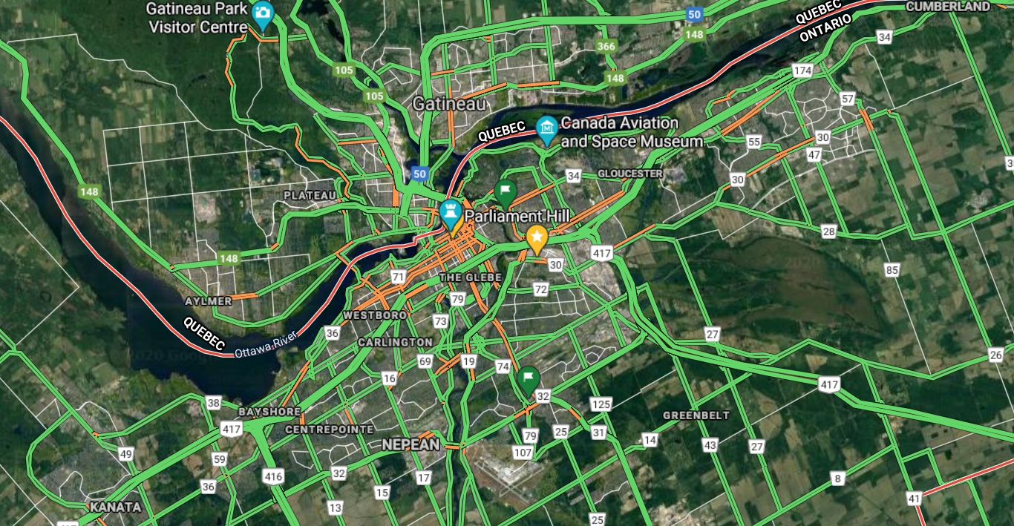
Data and Methodology
From Google Map API, we obtian the data of traffic flows at the traffic flows at 9 a.m., 12 p.m. and 5 p.m. during work day and weekends

Slide 8
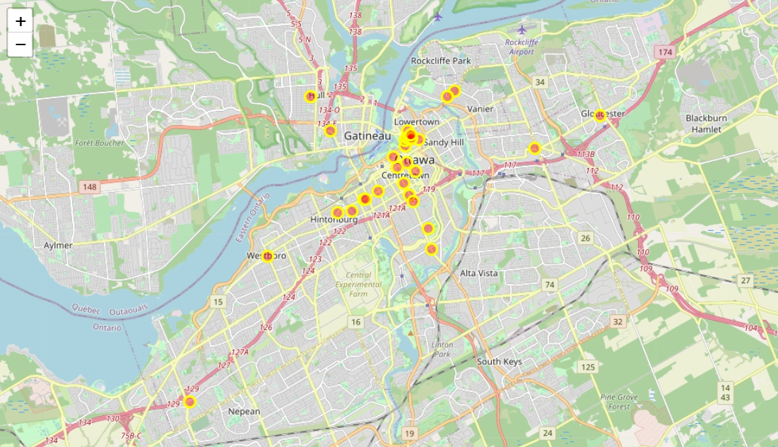
Analysis: popular shops

Slide 9
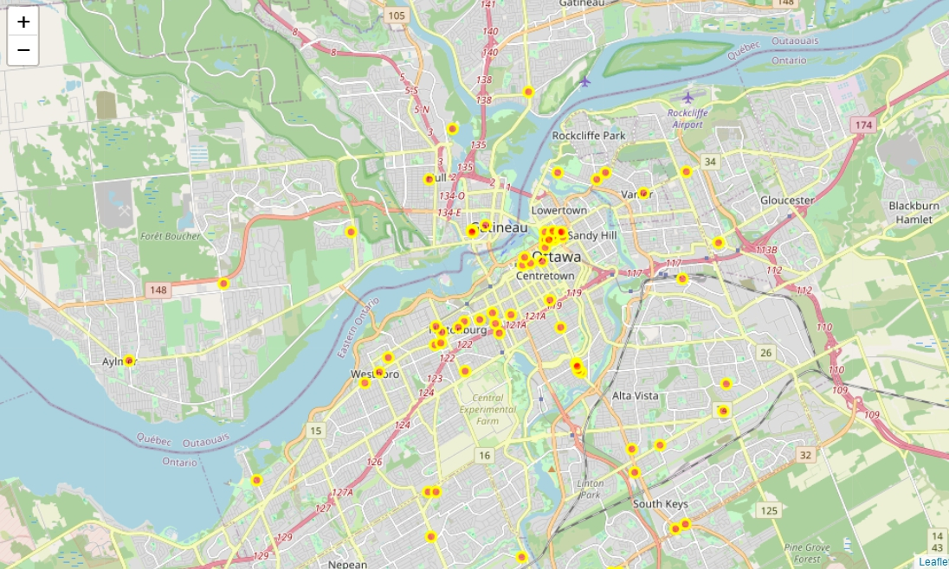
Analysis: high-ranked shops

Slide 10
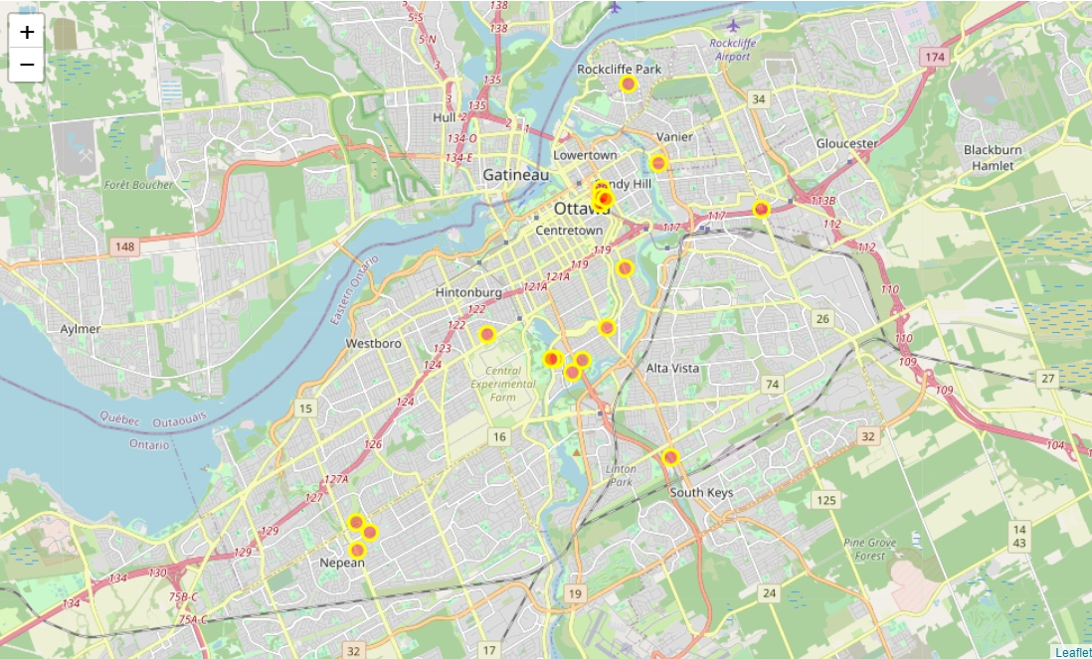
Analysis: universities & colleges

Slide 11
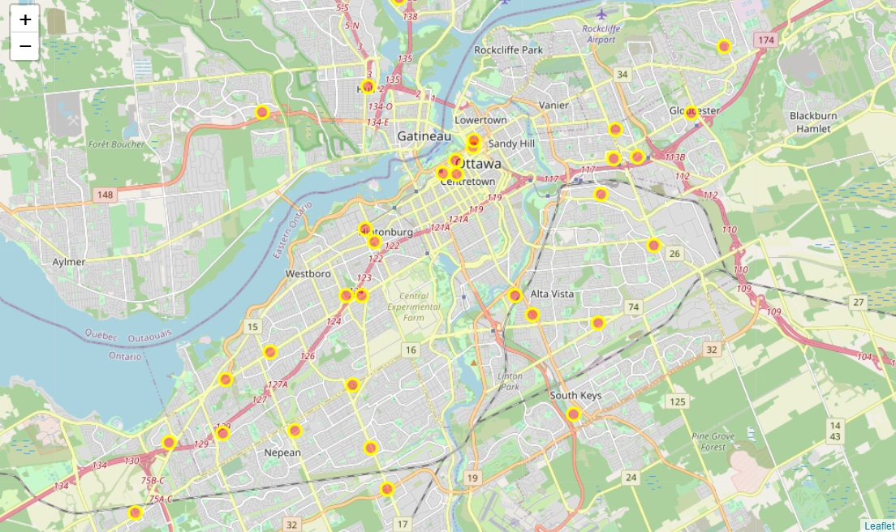
Analysis: shopping centers

Slide 12
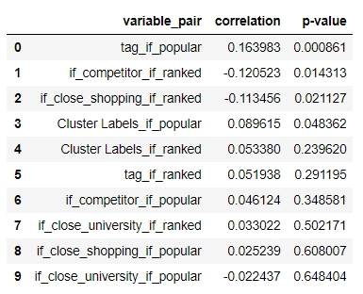
Analysis: correlation analysis

Slide 13
Conclusion
a good location for a coffee&tea shop should:
1) be close to neighbors such as bars and restaurants
2) get away from other competitors
3) have a diversity of different products/services (here, different types of drinks)
4) around the areas with a high level of traffic flows during morning, afternoon, and evening

Slide 14
Thanks for your watching!

